Slide 1

TMT – WEST 1 – AI – led Test Case Optimization
PALAGIRI GANESH HARSHA
M ARJUN
PARLA MURALI KRISHNA
RACHERLA REDDY REVANTH
C HARISH
Team: Harsha Team
S V College of Engineering

Slide 2
Business Need/ Opportunity
Identification of Business Problem
Need Assessment
Value Proposition

Slide 3
Business Problem/Need/Opportunity
SOFTWARE TESTING costs account for 15 to 25% of the total project cost of a typical software development project. Existing automation testing is not maintainable and not reusable as scripts get outdated, hence increasing maintenance costs.
In the current era, all software, websites, or apps, must be fortified with regular updates to keep up with changes in technology and user expectations. In traditional development formats, making changes to the application was rigid and a time-consuming task. However, advancements in tools and technologies, and the emergence of Agile methodologies have made it quite convenient for teams to modify the software at lightning speeds.
Nowadays, software is significantly used in many applications such as home appliances, Bank process, nuclear-power-plants, automobiles, telecommunications, medical devices and so on. The software testing process is a significant task to make it free from bugs and defects and to improve its quality. The software quality estimation uses several factors such as reliability, efficiency, software functionality, testability and so on. In these quality factors software reliability is a more significant factor due to it checks that how much software is consistent by tolerating failures during the life time of software .
Software testing is an investigation conducted to provide stakeholders with information about the quality of the software product or system under test (SUT). Usually, a software development organization expends between 30% to 40% of total project effort on testing and testing consumes more than 50% of the total cost of a project .
With constant advancements in technologies, the software testing process keeps evolving. Consequently, it becomes very challenging for QA teams to stay aligned with the best practices for fast, accurate testing.

Slide 4
Market Potential
Target Segment / Market Sizing

Slide 5
Target Segment/Market Size
Software Testing Market report analyses top opportunities in the market and summarize the features that are and will drive the progress of the industry. Reports also focus on earlier growing patterns, growth drivers, and present and upcoming trends, and also estimate the overall development of the global Software Testing Market market during 2022-2028.
Software testing is getting considered more seriously than ever before. The World Quality Report by Micro Focus has mentioned that 90% of businesses are experiencing growth in AI. This rise in using practices like DevOps and continuous testing is making the testing budget an indivisible part of software engineering budgets.
The same report says that 69% of businesses are meeting the quality goals. The value of quality assurance is getting appreciated by more and more businesses. As a result of this, there is a rise in the software testing business. Software testing companies are in demand to assist with this specialized work.
The global Software Testing market size is projected to reach US$ 262620 million by 2028, from US$ 83970 million in 2021, at a CAGR of 17.9% during 2022-2028. In terms of product, automated test is the largest segment, with a share over 80%. And in terms of application, the largest application is mobile, followed by PC.

Slide 6
Solution Details
Explanation/Articulation of Solution Idea
Differentiation/ Unique Selling Proposition
Solution Demo

Slide 7
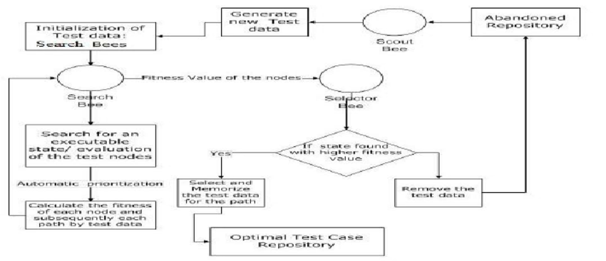
Algorithm

Slide 8
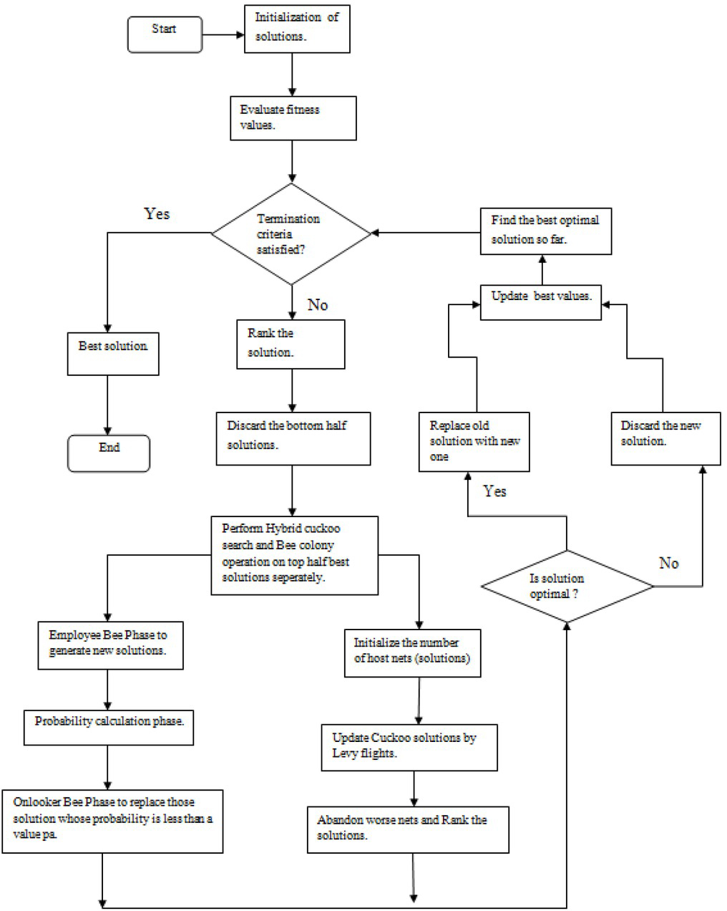

Slide 9
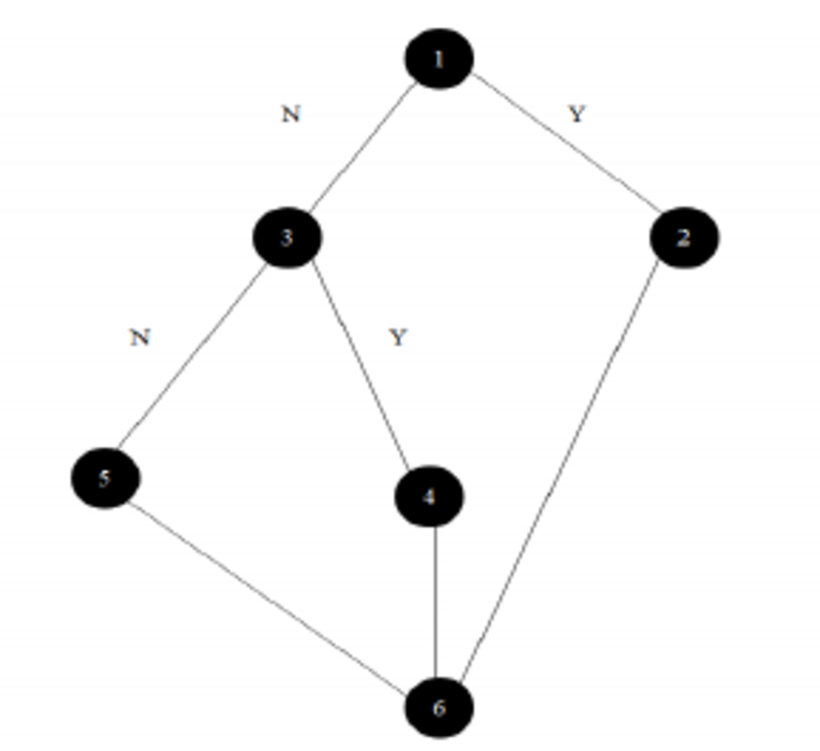
Case Study Example Testcases

Slide 10
Case Study
Programs used as case studies
Program1
If (j >=80)
{….. }
Else if (k >= 70)
{….. }
Else If (x >=60)
{….. }
Else If (y>=50)
{….. }
Else If (z>=25)
{….. }

Slide 11
Case Study
Experiments and results for program 1 In this test case a program with 5 variables (x,y,z,j,k) was used. According to Korel branch distance relation, the distance at first variable J would be zero if j - 80 >= 0, the distance at second variable K would be zero if K - 70 >= mas.ccsenet.org Modern Applied Science Vol. 12, No. 7; 2018 109 0, at the third variable X the distance would be 0 if x - 60 >= 0, at the next variable Y the distance would be 0 if y - 50 <= 0, and finally, the last variable will be 0 if z – 25.
The fitness value used for path of the program1 is 72, which is the sum of the previously mentioned distances calculated using the following equation (1): F= (J-80) + (K-70) +(X-60) +(Y-50) + (Z-25

Slide 12
Case Study
Programs used as case studies
Program 2
while (j >=75)
{….. }
while (k >= 65)
{….. }
while (x >=55)
{….. }
while (y>=45)
{….. }
while (z>=35)
{….. }

Slide 13
Case Study
Experiments and results for program 2 In the second test case, program 2 with 5 variables (x,y,z,j,k) was used. Again, Korel branch distance relation was used. The distance at first variable J would be zero if j - 75 >= 0, the distance at second variable K would be zero if K - 65>= 0, at the third variable the distance would be 0 if x - 55 >= 0, at the next variable the distance would be 0 if y - 45 <= 0, the last variable 0 if z – 35.
The fitness value used for path of program 2 is 54, which is the sum of the previously mentioned distances calculated according to the following equation: F= (J-75) + (K-65) +(X-55) +(Y-45) + (Z-35)

Slide 14
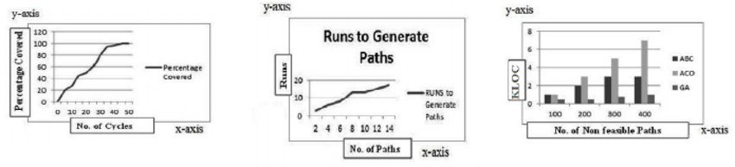
Workflow

Slide 15
Solution Details
The proposed approach attempts to solve the problem of Test Case Optimization by applying ABC algorithm. In the proposed approach each test case would represent a food source and the goal of the approach would be to find best food sources i.e. test cases with maximum coverage
ABC Algorithm
The food source position represents to a possible solution of the optimization problem and the nectar amount corresponds to the quality (fitness) of the associated solution. The basic steps of ABC algorithm [3] [11] [12] are:
Station the Search bees onto the food sources and ascertain their nectar amount.
• Compute the probability value of the sources with which they are opted by the
Selector bee.
• The process of the traversing of the food sources by desolated bees is halted.
• The scouts are sent into the search area for exploring new food sources randomly.
• The best food source found so far is retained in the memory

Slide 16
As explained earlier the entire functionality is divided as the functions of three kinds of bees. The three kinds of bees act as : • Search bee which act as Search agent • Selector bee which acts as Selector agent • Scout bee which acts as Replace agent The principle and working of the proposed approach: The approach is a population based approach . Here each test case comprises the possible solution in the optimization problem. The fitness value of each test case equates to the quality or the fitness of the colligated solution. An outline of the solution is presented the figure 1. The work proposes that the Optimised test suite generated by using the algorithm will contain all possible independent paths along with its test data.
Then the search bee passes the fitness value of the traversed nodes/neighbouring nodes to the selector agent. The selector bee compares the fitness value of nodes with the fitness value of the neighbouring nodes. If the node’s fitness value is found greater than the neighbouring node’s fitness value, the node’s information is stored in the optimal test case repository. The node whose fitness value is found less is pushed to the abandoned repository. The scout bee generates the new set of test data from the abandoned repository and again the same procedure of search bee is repeated. The algorithm for test case optimization using Artificial Bee Colony optimization approach is presented in the next section.

Slide 17
ABC OPTIMIZATION ALGORITHM
Initialize the Test Cases by initial test data generated by the tool. Initial test data is generated by the equivalence partitioning and boundary value analysis methods.
Step 1: The search bee employ test cases to the first executable node of the program. The fitness value of the test cases and the node information is returned to the employed bees.
Step 2: The Selector Bee takes the node information and fitness value of the test cases as the input and evaluates the fitness of each test case taken from the employed bees. Then the test case with the highest fitness value is stored in the memory or
repository.
Step 3: Then the neighbouring nodes of the covered nodes are searched by the employed bees and the fitness value of the current test case is explored against the neighbouring nodes by the onlooker bee.
Step 4: The node with the highest fitness value is picked out and tagged with the current node which forms the test path. This information of the test path is stored in the Optimal Test repository.
Step 5: Rest of the nodes other than the covered node and the test cases other than the selected test case are abandoned and they are stored in a temporary abandoned repository.
Step 6:
Repeat the steps 3 to 6 till the test path is not complete Else the nodes and the test cases from the abandoned repository are selected for the next test path generation by the employed bees
Step 7: The scout bee bring forth a new population of test cases and replaces the test cases of the abandoned repository with the new test cases if the onlooker bee finds the selected test cases are not efficient.
Until the user defined termination criterion is met.

Slide 18
speechrecognition
In order to implement any algorithm, the algorithm must be converted into the pseudo code before programmatically developing an application. The detailed pseudo code of the Test Case Optimization algorithm using ABC approach is presented in the
following section.
The following is the detailed algorithm
1. Initialise the test cases which is performed by the search bee (Algorithm fig)
2. Search for an executable state and evaluate the test nodes
3. Initialise the current traversal path as cycle=1
4. Repeat
5. Produce new test cases vij in the neighbourhood of xij for the the search agent
using the formula
Xij=minj+rand (0, 1)*(maxj-minj)
• Xij is the initial test case
• minj is the minimum no. of test cases
• maxj is the maximum no. of test cases
• rand () is a random number generation function which selects either 1 or 0
randomly.
6. Generate the test data using equivalence partitioning and boundary value analysis.
7. Apply greedy selection process [18] for the generated test data.
8. Traverse the SUT with the generated Test Data and calculate the fitness value.
9. The onlooker selects the test cases with the highest fitness value and abandons the rest
10. The traversal process is carried out till a particular test data with 100% fitness value and 0% fitness value is produced

Slide 19
speechrecognition
Pi=(fiti)/∑(fiti) [16]
Where Pi isthe probability function which signifies the probability with which the I test data traversers a independent test path successfully.
11. Add the test case to the optimal repository
12. In the next iteration scouts generate the new test data and go to step 5
To implement the above algorithm, our approach uses the ABC Test Suite Optimization tool to optimize the Test Cases by employing the ABC algorithm. The tool considers a program as an input to generate independent paths. Using the generated independent paths Test Cases are traversed along the paths with the help of ABC algorithm. By doing so the test cases with maximum coverage (High fitness Value) are recognized. Finally the optimal Test Suite is generated.

Slide 20
Use Case View
The use case view describes the functional requirements and scenarios of the system from the perspective of the actors interacting with it. Based on the provided case study and the code snippet, we can design the following use cases for the AI-led Test Case Optimization system:
Optimize Test Cases:
Actor: User
Description: This use case allows the user to initiate the optimization of test cases using the AI/ML algorithms.
Main Flow:
The user selects the "Optimize Test Cases" option.
The system presents the available programs as case studies (e.g., Program1, Program2).
The user selects a specific program as the optimization target.
The system retrieves the dataset associated with the selected program.
The system applies the AI/ML optimization algorithms to generate optimal test cases.
The system presents the optimized test cases to the user.
Alternative Flows:
If no dataset is available for the selected program, the system notifies the user and prompts for dataset upload or selection from an external source.
If the optimization process encounters errors or fails, the system provides error messages and suggests troubleshooting steps.

Slide 21
Use Case View
Execute Test Cases:
Actor: User
Description: This use case allows the user to execute the generated or selected test cases.
Main Flow:
The user selects the "Execute Test Cases" option.
The system presents the available test cases for execution.
The user selects one or multiple test cases to execute.
The system executes the selected test cases on the target program.
The system captures the results of the test case execution.
The system presents the test case results to the user.
Alternative Flows:
If no test cases are available for execution, the system notifies the user and suggests running the test case optimization process first.

Slide 22
Use Case View
If the test case execution encounters errors or fails, the system provides error messages and suggests troubleshooting steps.
Adjust Optimization Parameters:
Actor: User
Description: This use case allows the user to adjust the parameters used in the test case optimization process.
Main Flow:
The user selects the "Adjust Optimization Parameters" option.
The system presents the current optimization parameters (e.g., fitness thresholds).
The user modifies the parameters according to their preferences.
The system applies the updated parameters in the optimization process.
The system notifies the user of the parameter adjustments and their impact on the optimization results.
Alternative Flows:
If the user modifies invalid or out-of-range values for the optimization parameters, the system provides validation messages and prompts for valid inputs

Slide 23
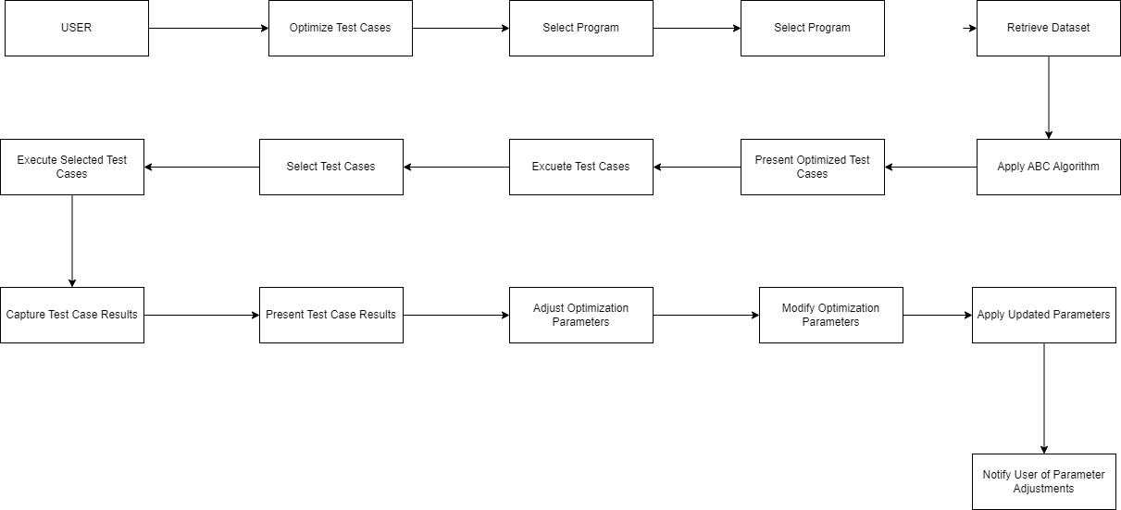
Use Case View

Slide 24
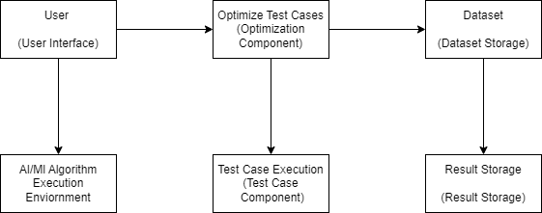
Deployment Model

Slide 25
Future Readiness
Solution Roadmap
Cross-Industry application

Slide 26
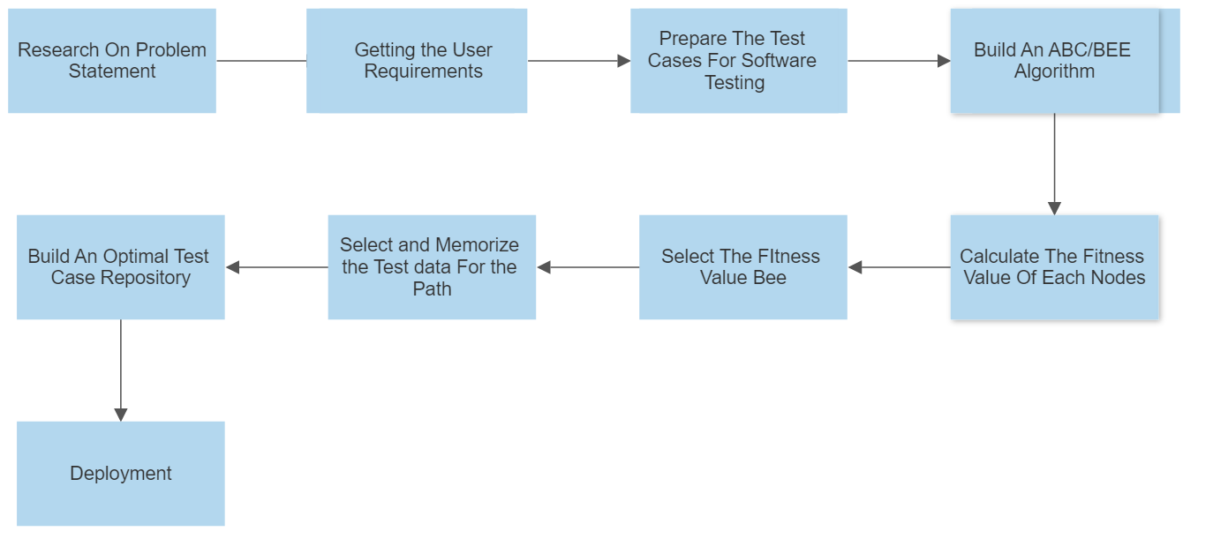
Future Readiness

Slide 27
Cross-Industry application
Yes, With the Help of AI/ML Algorithm model can be used for different applications and industries.

Slide 28
Conclusion
This presentation Artificial Bee Colony Algorithm based (ABC) to test data generation for software structural testing particularly, path testing. It applies Meta heuristic measure which detect optimal result to find fitness stop if result might be found. Efficiently optimal fitness value among a set of values was found, from the local minimal fitness values among search. The presented approach have been tested to by execute ABC algorithm over creating testing data for the criteria of path coverage testing. The results show the success and the ability of the ABC algorithm in software path testing by finding the optimal fitness values.

Slide 29
About the Team
I deeply appreciate every member of this team for showing relentless effort for this project. It gives me great pride to be the leader of this team. Your hard work continues to inspire me. I see and appreciate everything you do for the company.
In one of my previous projects, our team was tasked with developing a complex software solution within a tight deadline. As the project progressed, we faced numerous challenges and had to work collaboratively to overcome them.

Slide 30
TEAM Members
PALAGIRI GANESH HARSHA
PARLA MURALI KRISHNA
M ARJUN
RACHERLA REDDY REVANTH
C HARISH

Slide 31
Thank You
Notes:
Leading industry analysts and awards organizations have recognized Virtusa for our exceptional quality in digital engineering and transformational IT capabilities.
Highlights:
Virtusa's vLife™ platform in the Best New Product or Service of the Year - Health & Pharmaceuticals - Product category. vLife™ is a ready-to-use collaborative platform, built on a large clinical data lake that models disease progression or population-level risk categorization. By unifying data, AI, and IoT, Virtusa is helping the healthcare market address key pain points.

